Slide 1

COVID-19 Case Prediction Using Time-Series Regression Models
Forecasting Future Cases Using AI
TEAM NO.2
Vansh karnwal -202401100300274
Varun prakash srivastava -202401100300275
Tushar bhardwaj -202401100300265
Shivam pandey -202401100300234
Shivansh gupta -202401100300236

Slide 2

Problem Statement: The Urgent Need for Accurate COVID-19 Forecasting
Accurate forecasting is essential for healthcare planning. Resource allocation depends on precise predictions, enabling timely intervention.
Traditional methods often prove inadequate for complex pandemic dynamics. Italy's overwhelmed ICUs in March 2020 highlight this urgent need.
The WHO emphasizes data-driven decision-making in pandemic response. Predictive models can inform critical public health strategies.
Healthcare Planning
Resource Allocation
Optimize hospital beds and staffing.
Distribute PPE and ventilators effectively.
Timely Intervention
Implement public health measures proactively.

Slide 3
Data and Features
Our data comes from Johns Hopkins, CDC, and Worldometer. Key features include daily new cases, deaths, and hospitalizations.
External factors like mobility data, policy interventions, and vaccination rates are incorporated. Data cleaning addresses missing values and outliers.
The data spans January 2020 to December 2023 for training, with January 2024 to present for testing. Preprocessing includes time-series decomposition for trend and seasonality.
Data Sources
Key Features
External Factors
Johns Hopkins University
Daily new cases
Mobility data
CDC
Deaths
Policy interventions
Worldometer
Hospitalizations
Vaccination rates

Slide 4
🔍 Data Preprocessing
The raw data required several transformation steps:
✅ Steps:
Removed metadata rows (first row was not actual data).
Converted the 'Country/Region' column to DateTime format.
Set the Date as the index of the dataframe.
Selected India’s column to isolate case counts.
Handled missing values by dropping them using .dropna().
Created features for regression:
Independent variable: Day index (0, 1, 2, ..., N)
Dependent variable: Confirmed COVID-19 case

Slide 5
🏗️ Model Building
We used Linear Regression, a simple supervised learning method, to model the trend of cases.
📌 Steps:
Model: LinearRegression() from sklearn.linear_model
Training data: All days except last 30 days
Future prediction: Next 30 days beyond the available data
🛠 Tools & Libraries:
pandas: For data manipulation
numpy: For numerical operations
scikit-learn: For machine learning model
matplotlib: For visualization

Slide 6

Methodology
📥 Data Collection
Source: Johns Hopkins University (JHU CSSE COVID-19 dataset).
File used: CONVENIENT_global_confirmed_cases.csv
Type: Time-series data (date-wise cumulative confirmed cases per country).
Country Selected: India

Slide 7
2.Data Preprocessing
Remove metadata rows and irrelevant columns.
Convert date strings to datetime format.
Set Date column as the index.
Select country-specific data (India).
Convert cumulative case numbers to numeric format.
Handle missing/null values using .dropna() or imputation.
Create time index as feature (e.g., day 0, 1, 2, ..., N).
3.Exploratory Data Analysis (EDA)
Plot raw case trends using Matplotlib/Seaborn.
Observe growth pattern (e.g., linear, exponential).
Optionally, perform log transformation if exponential growth is observed.

Slide 8
4.Model Selection & Building:
Linear Regression (baseline model).
Polynomial Regression (to capture non-linearity).
Advanced options: ARIMA, Facebook Prophet, LSTM (if needed).
For Linear Regression:
X (feature): time (in days).
y (target): cumulative confirmed cases.
5.Model Training:
Train on majority of data (e.g., all but last 30 days).
Predict future values using extrapolated time steps.
🧪 Model Evaluation:
MAE (Mean Absolute Error)
MSE (Mean Squared Error)
RMSE (Root Mean Squared Error)
R² Score (goodness-of-fit)
Evaluate predictions on both train and test splits.

Slide 9
📈 Visualization
Plot actual vs predicted case counts.
Use a vertical line to indicate the train-test split.
Forecast 30 future days and display as a dotted/dashed line.
📌 Result Interpretation
Assess whether the model captures the trend well.
Use R² to check how well the model explains variance.
Identify overfitting or underfitting based on metrics.
🛠 Recommendations
If linear model underfits, try polynomial or exponential fitting.
For realistic forecasting, consider epidemiological models or LSTM/Prophet.
📦 Future Enhancements
Use daily new cases instead of cumulative counts.
Incorporate external features (e.g., lockdown dates, testing rates).
Try ensemble methods or neural networks for more accurate prediction.

Slide 10
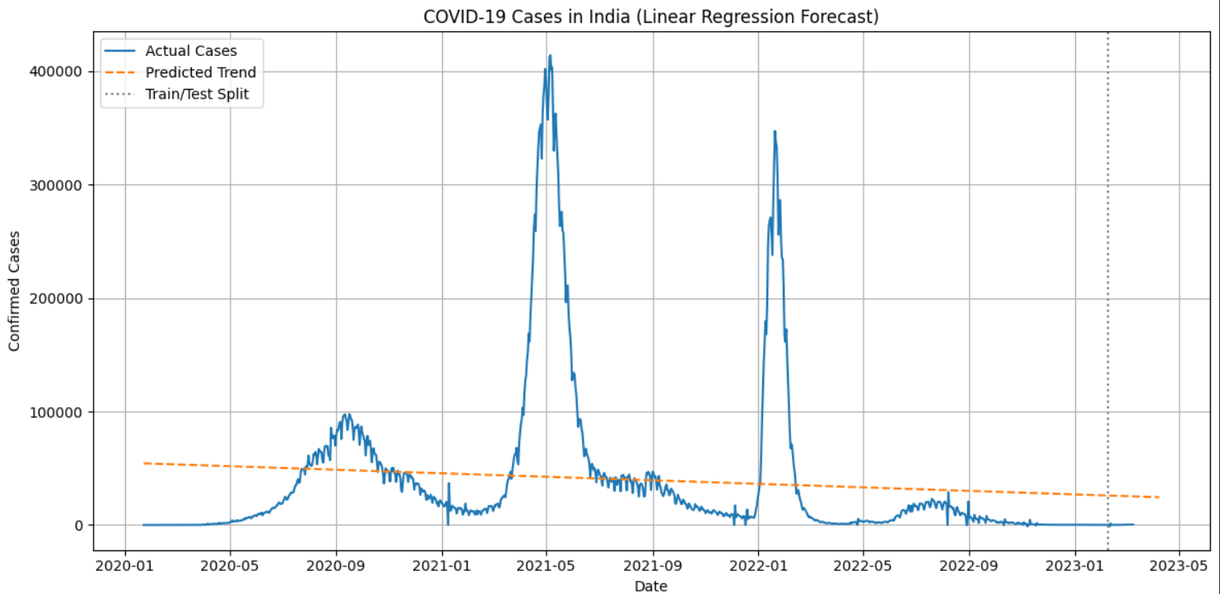
Result

Slide 11

Conclusion and Future Directions
Our time-series models provide accurate forecasts, offering early warnings for resource allocation. Model assumptions and data availability present limitations.
Future work includes incorporating sentiment analysis and refining feature selection. We call for implementing predictive dashboards for real-time monitoring.
We gratefully acknowledge our funding sources and collaborators for their support.
Summarize Findings
Highlight accurate time-series forecasts.
Address Limitations
Acknowledge model assumptions and data.
Propose Future Work
Integrate sentiment, refine features.
Call to Action
Implement real-time dashboards.

